Slide 1


Slide 2
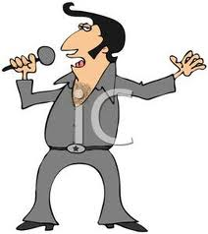
Content:
DEFINITION
INTRODUCTION
CAUSES OF CONFLICT
TYPES OF CONFLICT
CONFLICT: CONSTRUCTIVE VS DESTRUCTIVE
MODELS PREDICTING WORK PLACE BEHAVIOUR
CONFLICT MANAGEMENT
EFFECT OF CONFLICT ON BUSINESS
SURVEY RESULTS
SOME TIPS FOR MANAGING WORK PLACE CONFLICT

Slide 3
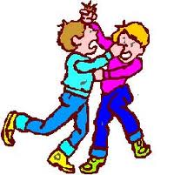
1. Definition of Conflict..
CONFLICT IS AN INEVITABLE AND UNAVOIDABLE PART OF OUR EVERYDAY PROFESSIONAL AND PERSONAL LIVES.

Slide 4
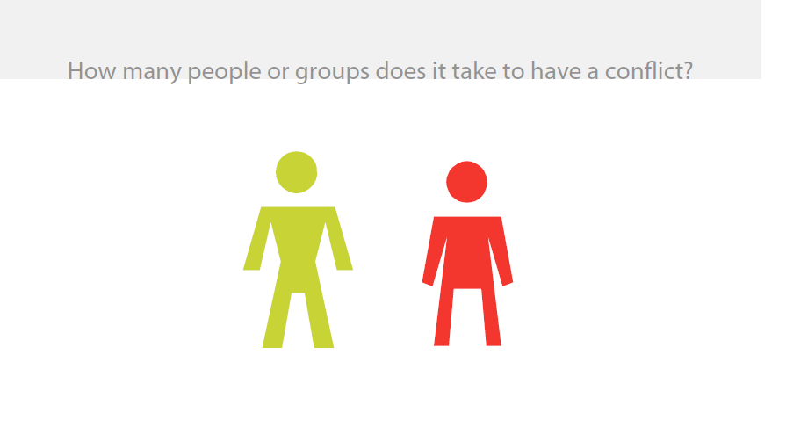
2. Introduction:

Slide 5
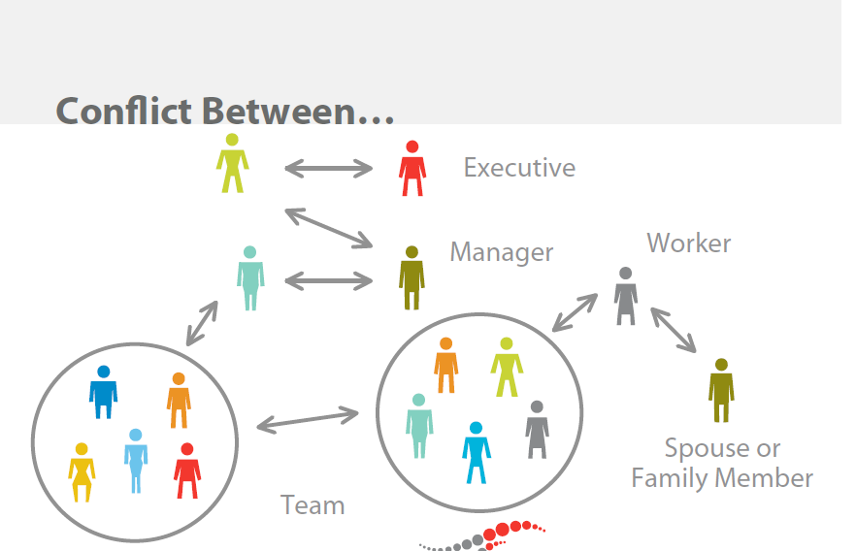

Slide 6
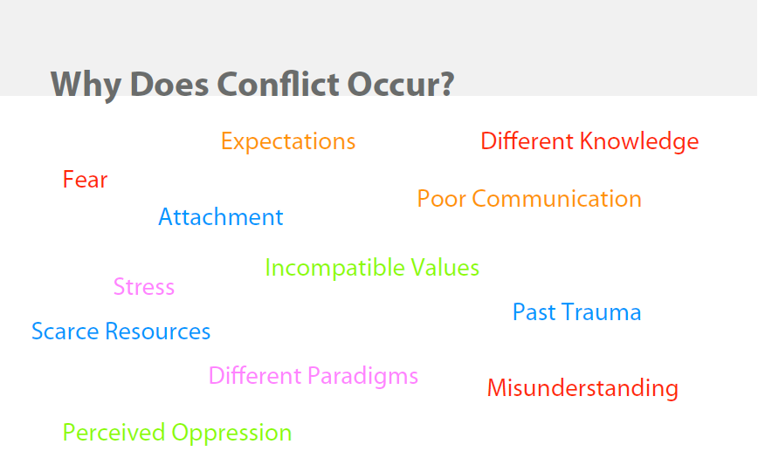


Slide 7
REALITY OF CONFLICT & EFFECTIVE COMMUNICATION
CONFLICT BETWEEN PEOPLE IS A FACT OF LIFE
CONFLICTS OCCUR AT ALL LEVELS OF INTERACTION.
THUS, CONFLICT IS A CRITICAL EVENT IN THE COURSE OF A RELATIONSHIP.
WHETHER A RELATIONSHIP IS HEALTHY OR UNHEALTHY DEPENDS NOT SO MUCH ON THE NUMBER OF CONFLICTS BETWEEN PARTICIPANTS, BUT ON HOW THE CONFLICTS ARE RESOLVED.

Slide 8
3. Causes of conflict
  Misunderstanding
  Personality clashes
  Competition for resources
  Authority issues
  Lack of cooperation
  Differences over methods or style
  Low performance
  Value or goal differences

Slide 9
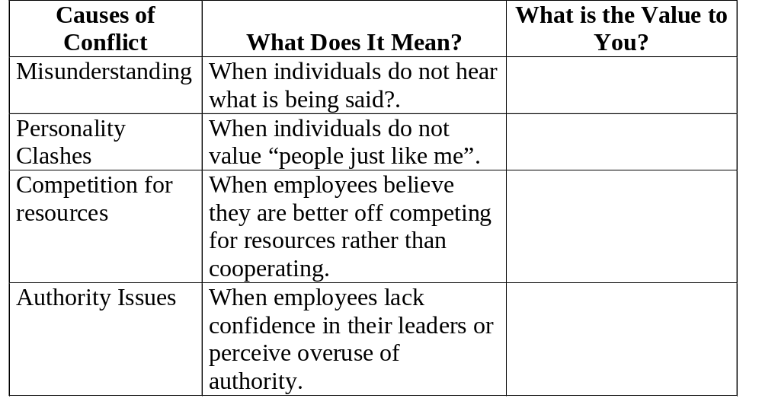
Assumptions about, Causes of and Value of Conflict

Slide 10
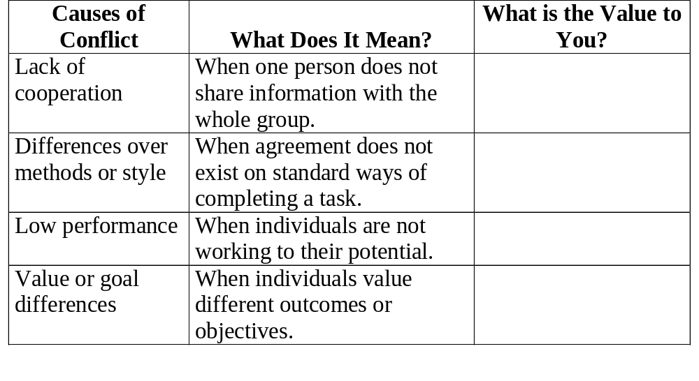
Assumptions about, Causes of and Value of Conflict

Slide 11
4. Types of Conflict
Model for diagnosis and management of conflict
Type of Conflict
Sources of Conflict
Management Strategy
1.
Intra individual
Conflicting goals, needs, motives
Role Definition
2.
Interpersonal
Disagreements antagonism
IPC Skills,TA, Johari-Window, Creative P S, Assertive Behaviour
3.
Inter-group
Power, Authority Status
Participative Mgt.
Team Bldg.Training
4.
Organizational
Hierarchical Conflict Functional conflict
Institutional Goal setting
5.
Client Hospital
Quality of patient care and communication
Community Goal Setting, Public Relations

Slide 12
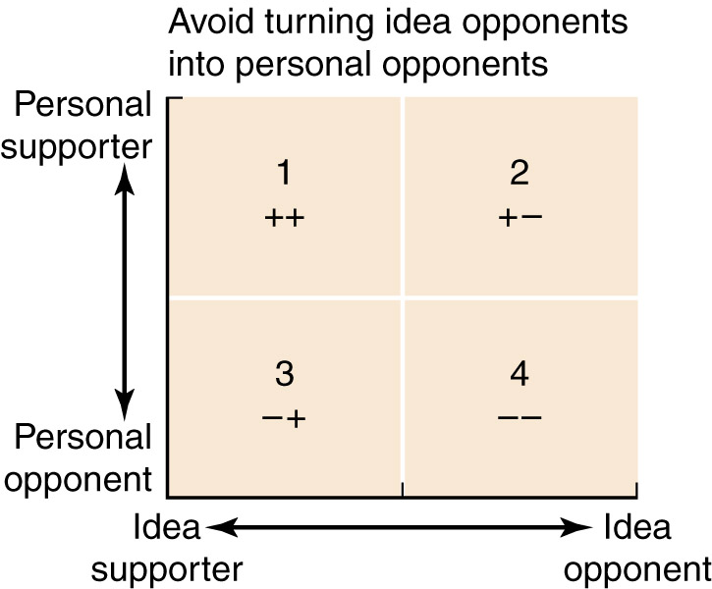
Types of Conflict
Opposition and Support

Slide 13

5. CONFLICT: CONSTRUCTIVE VS DESTRUCTIVE
The Value of Conflict
Conflict is destructive when it:
Diverts energy from more important issues and tasks.
Deepens differences in values.
Polarizes groups so that cooperation is reduced.
Destroys the morale of people or reinforces poor self-concepts.

Slide 14

The Value of Conflict
Conflict is constructive when it:
Opens up issues of importance, resulting in issue clarification.
Helps build cohesiveness as people learn more about each other.
Causes reassessment by allowing for examination of procedures or actions.
Increases individual involvement.

Slide 15
Desirability of Conflict
CONFLICT: DESIRABILITY VS UNDESIRABILITY
Conflict can be desirable.
Conflict helps eliminate or reduce the likelihood of groupthink.
A moderate level of conflict across tasks within a group resulted in increased group performance while conflict among personalities resulted in lower group performance (Peterson and Behfar, 2003)

Slide 16
Undesirability of Conflict
Conflicts can be hard to control once they have begun.
  The trend is toward escalation and polarization.
  When conflict escalates to the point of being out of control, it almost always yields negative results.

Slide 17
CONFLICTS ARE DYSFUNCTIONAL
CONFLICTS: FUNCTIONAL VS DYSFUNCTIONAL
CONFLICT IS AN INDICATION THAT SITUATION IS THREATENING, DEVASTATING OR ON A POINT OF BREAKING.
CONFLICTS ARE UNPRODUCTIVE AND DYSFUNCTIONAL.
CONFLICTS CAN DELAY OR PREVENT THE ATTAINMENT OF A GOAL OR FRUSTRATE AN INDIVIDUAL. IN HOSPITAL SITUATION
CONFLICT IS INEVITABLE

Slide 18
CONFLICT ARE FUNCTIONAL
ALL CONFLICTS ARE NOT UNPRODUCTIVE.
CONFLICTS CAN BE USEFUL CONSTRUCTIVE, AND POSITIVE
IN FACT, A RELATIONSHIP WITH FREQUENT CONFLICT MAY BE HEALTHIER THAN ONE WITH NO OBSERVABLE CONFLICT
CONFLICT CAN PROMOTE INNOVATION, CREATIVITY AND DEVELOPMENT OF NEW IDEAS, WHICH MAKE ORGANISATIONAL GROWTH POSSIBLE.
IF IT IS HANDLED WELL, HOWEVER, CONFLICT CAN BE PRODUCTIVE – LEADING TO DEEPER UNDERSTANDING, MUTUAL RESPECT AND CLOSENESS.
AND THE REALITY IS ALL THE MAJOR REFORMS AND CHANGES OCCUR AS A CONSEQUENCE OF CONFLICT

Slide 19
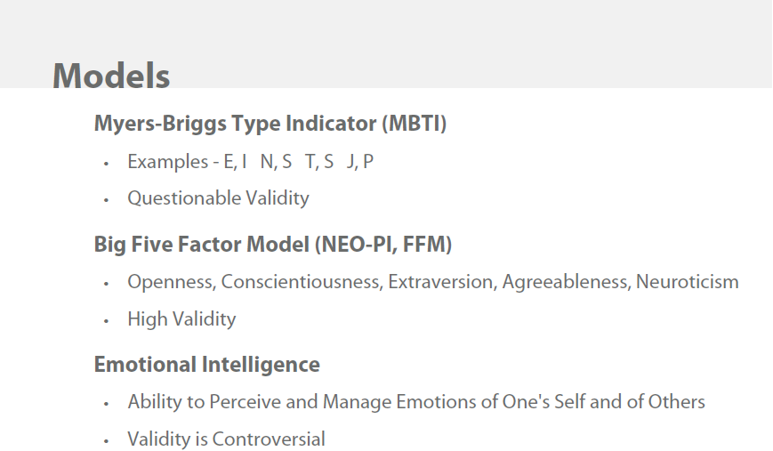
6. Models predicting work place behavior / personality:

Slide 20
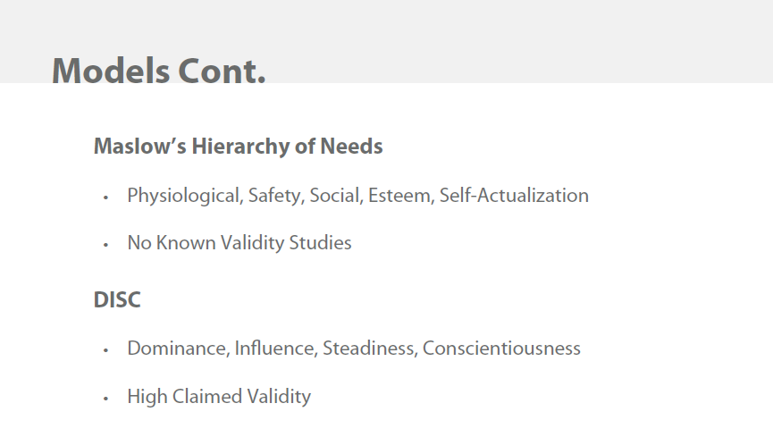
Models predicting work place behavior / Motivation:

Slide 21
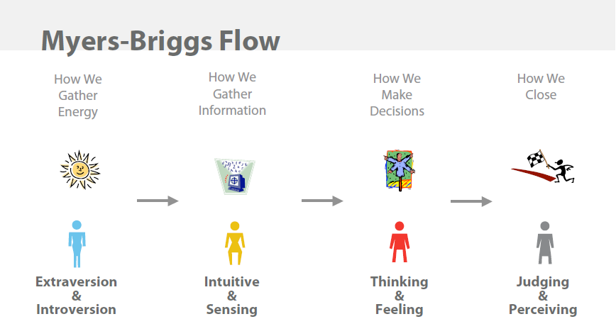

Slide 22
Game Theory
Game theory puts people into the mixed-motive situation.
  Covey (1990) in The Seven Habits of Highly Successful People refers to the scarcity mentality versus the abundance mentality.
    The scarcity mentality leads us to resent the success of others.
    The abundance mentality allows us to think of situations in which everybody can win.

Slide 23
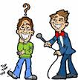
7. Conflict Management
Conflict management is defined as “the opportunity to improve situations and strengthen relationships” (BCS, 2004).
–proactive conflict management
–collaborative conflict management

Slide 24
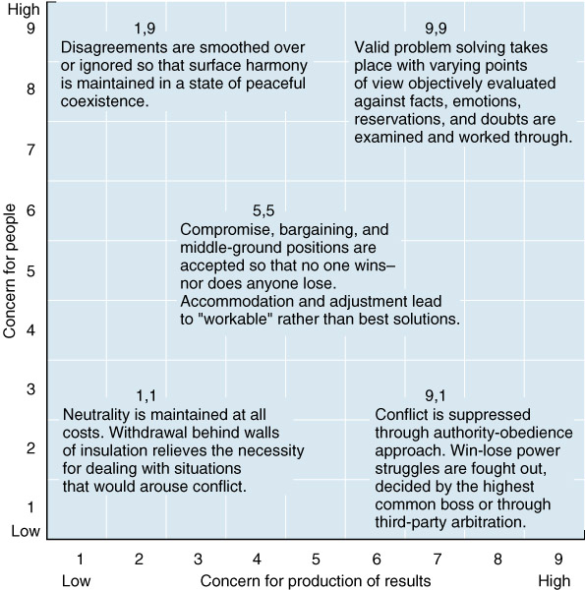
Toward Conflict Management
Blake and Mouton’s Conflict Grid
Source: Reproduced from Robert R. Blake and Jane Syngley Mouton. “The Fifth Achievement.” Journal of Applied Behavioral Science 6(4), 1970..

Slide 25
Toward Conflict Management
Blake and Mouton (1970) proposed a grid that shows various conflict approaches.
  The 1,1 style is the hands-off approach, also called avoidance.
  The 1,9 position, also called accommodation, is excessively person-oriented.

Slide 26
Toward Conflict Management
  The 5,5 position represents a willingness to compromise.
  The 9,1 is the bullheaded approach, also called competing.
  The optimum style for reducing conflict is the 9,9 approach, also called collaboration.

Slide 27
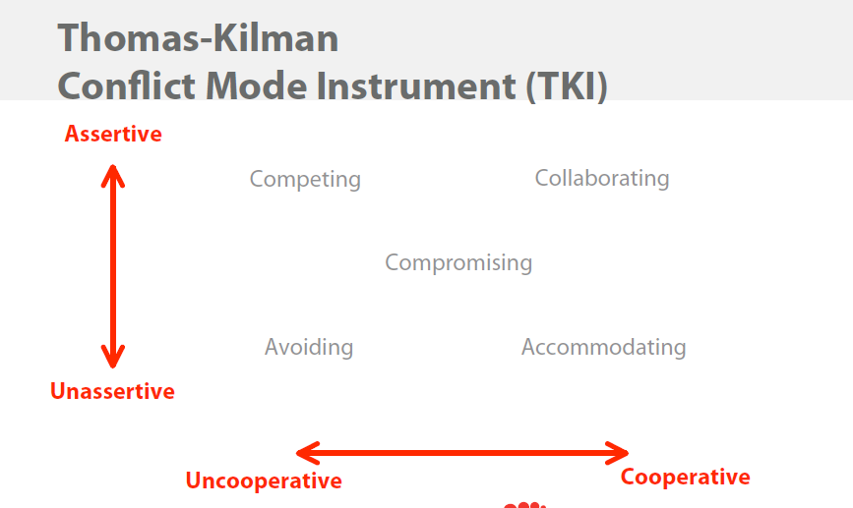

Slide 28
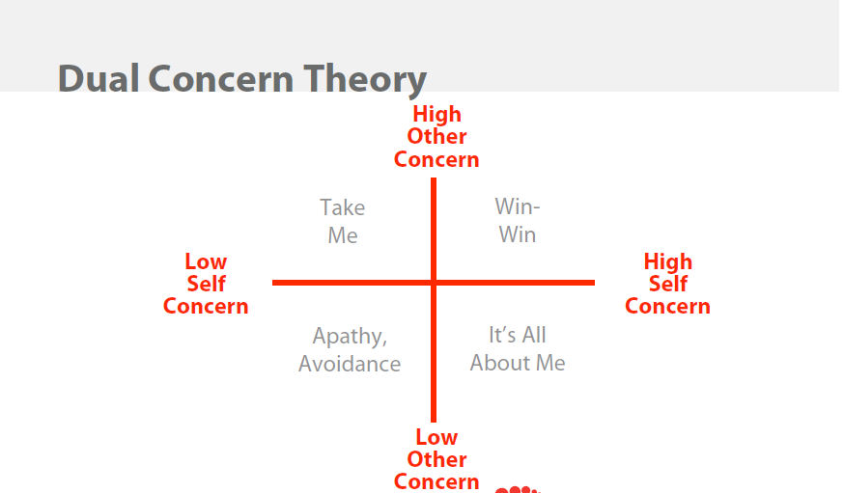

Slide 29
INTERPERSONAL COMMUNICATION SKILLS
COMMUNICATION IS EXCHANGE OF INFORMATION, IDEAS AND MOST IMPORTANTLY FEELINGS. THE PURPOSE IS TO GET YOUR MESSAGE ACROSS TO OTHERS CLEARLY AND UNAMBIGUOUSLY

Slide 30
POSITIVE IPC APPROACHES TO CONFLICT RESOLUTION
THE UNDERLYING PRINCIPLE THAT UNDERSCORES ALL SUCCESSFUL CONFLICT RESOLUTION.
THAT IS, BOTH PARTIES MUST VIEW THEIR CONFLICT AS A PROBLEM TO BE SOLVED MUTUALLY SO THAT BOTH PARTIES HAVE THE FEELING OF WINNING – OR AT LEAST FINDING A SOLUTION WHICH IS ACCEPTABLE TO BOTH

Slide 31
BARRIERS TO COMMUNICATION
PHYSICAL OR PERSONAL
ENVIRONMENTAL

Slide 32
IPC SKILLS
VERBAL SKILLS
NONVERBAL SKILLS
LISTENING SKILLS
FEEDBACK SKILLS

Slide 33
BEHAVIOR AND ATTITUDE DETERMINE EACH SKILL
BEHAVIOR
AGGRESSIVE
PASSIVE
ASSERTIVE
ATTITUDE
SYMPATHY
APATHY
EMPATHY

Slide 34
IPC HELPS IN PREVENTING CONFLICT
TO PREVENT CONFLICT FROM HAPPENING IN THE FIRST PLACE, IDENTIFY THE WAYS IN WHICH WE CONTRIBUTE TO DISAGREEMENT IN CERTAIN COMMUNICATION PATTERNS.
IDENTIFY A SPECIFIC, RECENT CONFLICTING SITUATION, RECALL WHAT YOU SAID, THINK SPECIFICALLY ABOUT HOW YOU COULD HAVE USED MORE EFFECTIVE VERBAL SKILLS
THINK ABOUT WAYS IN WHICH YOUR COMMUNICATION HAD SET A MORE TRUSTFUL TONE OR OFFENSIVE TONE

Slide 35
SELF-AWARENESS
SELF-AWARENESS INCLUDES A RECOGNITION OF OUR PERSONALITY, OUR STRENGTHS AND WEAKNESSES, OUR LIKES AND DISLIKES.
A PREREQUISITE FOR EFFECTIVE COMMUNICATION RELATIONS,AND MANAGING CONFLICT AS WELL AS FOR DEVELOPING EMPATHY FOR OTHERS.

Slide 36
Information known to every one
Knowledge belongs only to Others
What we know and what they know
What they know and we do not know
Share
Feedback
What we know and they do not know
What we do not know and they do not know
Knowledge belongs only to Self
Knowledge acquired by learning together

Slide 37
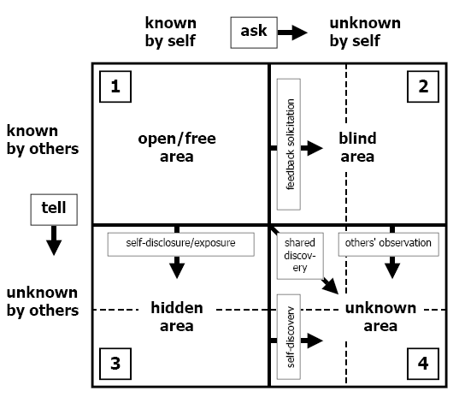
MOVING TOWARDS OPEN SELF

Slide 38
Transactional Analysis
Transactional analysis (TA): a method of understanding behavior in interpersonal dynamics.
Provides helpful models for leadership styles
Used with organizational development
Used to help managers operate effectively within other cultures
Chapter 8 Transactional Analysis, Assertiveness, and Conflict Resolution

Slide 39
Transactional Analysis (I)
The three ego states
Parent:
  Critical parent – Behavior with evaluative responses that are critical, judgmental, opinionated, demanding, disapproving, etc.
  Nurturing parent – behavior with reassuring responses that are protecting, consoling, permitting, caring, etc.
Child:
  Natural child – Behavior with probing responses that show curiosity, intimacy, fantasy, etc.
  Little professor – Behavior with thinking responses that show creative, manipulative etc.
  Adapted child – Behavior with confronting responses that express rebelliousness, pouting, anger, anxiety, fear, etc.
Adult:
Behavior with thinking, rational, calculating, factual, unemotional, etc.

Slide 40
Types of Transactions
Complementary:
  Occurs when the sender of the message gets the intended response from the receiver.
  Result in more effective communication with fewer hurt feelings and arguments.
Crossed:
  Occurs when the sender of a message does not get the expected response from the receiver.
  Result in surprise, disappointment, and hurt feelings for the sender of the message.
Ulterior or Hidden:
  Occurs when the words seem to be coming from one ego state, but in reality the words or behaviors are coming from another.

Slide 41
Life Positions
Positive
Negative
I’m OK — I’m OK —
You’re not OK You’re OK
I’m not OK — I’m not OK —
You’re not OK You’re OK
Attitude toward Oneself
Positive Negative
Attitude toward Others

Slide 42
Stroking
Stroking: is any behavior that implies recognition of another’s presence.
Can be positive and negative.
Powerful motivation technique.
Positive strokes should always be giving.
Chapter 8 Transactional Analysis, Assertiveness, and Conflict Resolution

Slide 43
Assertiveness
Assertiveness: is the process of expressing thoughts and feelings while asking for what one wants in an appropriate way.
When people stand up for their rights without violating the rights of others, they are using assertive behavior.
A way of presenting a message without falling into stereotypical “too pushy” (aggressive) or “not tough enough” (nonassertive-passive) traps.
Chapter 8 Transactional Analysis, Assertiveness, and Conflict Resolution

Slide 44
Assertiveness
Speakers Behaviors
Passive speakers use self-limiting qualifying expressions without stating their position/needs.
Assertive speakers state their position/needs without violating the rights of others.
Aggressive speakers state their position/needs while violating the rights of others using “you messages” and absolutes.
Passive-aggressive speakers may switch back and forth, may switch immediately after the situation, or may build hostility while behaving passively.
Chapter 8 Transactional Analysis, Assertiveness, and Conflict Resolution

Slide 45
Assertiveness
Comes through the adult ego state
I’m OK — You’re OK.
Creates a win-win situation.
To be assertive:
  Set an objective.
  Determine how to create a win-win situation.
  Develop an assertive phrase (s).
  Implement your plan persistently.
Chapter 8 Transactional Analysis, Assertiveness, and Conflict Resolution

Slide 46
Conflict Management Styles
Forcing conflict style: user attempts to resolve conflict by using aggressive behavior.
Avoiding conflict style: user attempts to passively ignore the conflict rather than resolve it.
Accommodating conflict style: user attempts to resolve the conflict by passively giving in to the other party.
Compromising conflict style: user attempts to resolve the conflict through assertive give-and-take concessions.
Collaborating conflict style: user assertively attempts to jointly resolve the conflict with the best solution agreeable to all parties.

Slide 47
Competition
Plus
  The winner is clear
  Winners usually experience gains
Minus
  Establishes the battleground for the next conflict
  May cause worthy competitors to withdraw or leave the organization
Notes:
Ask students to volunteer examples here.

Slide 48
Accommodation
Plus
  Curtails conflict situation
  Enhances ego of the other
Minus
  Sometimes establishes a precedence
  Does not fully engage participants
Notes:
Ask students to volunteer examples here.

Slide 49
Compromise
Plus
  Shows good will
  Establishes friendship
Minus
  No one gets what they want
  May feel like a dead end
Notes:
Ask students to volunteer examples here.

Slide 50
Collaboration
Plus
  Everyone “wins”
  Creates good feelings
Minus
  Hard to achieve since no one knows how
  Often confusing since players can “win” something they didn’t know they wanted
Notes:
Ask students to volunteer examples here.

Slide 51
Conflict Continuum
I win, you lose (competition—A)
I lose or give in (accommodate—B)
We both get something (compromise—C)
We both “win”(collaborate—D)
      A B C D
Notes:
First, let’s think about conflict as it unfolds for you. Think about one example (personal or professional) of when you used a particular style and tell us how that position worked for you.
Here are pluses and minuses for each style:

Slide 52

Conflict Management Styles
I’m
not OK —
You’re OK
I’m OK —
You’re OK
Passive
behavior
Assertive
behavior
High concern
for others’
needs
Accommodating
style
Collaborating
style
Compromising
style
Aggressive
behavior
Avoiding
style
Forcing
style
I’m
not OK —
You’re not OK
I’m OK —
You’re not OK
Low concern
for others’
needs
High concern
for own
needs

Slide 53

Conflict orientation and the conflict aftermath
Avoidance
Accommodative
Dominance
Collaborative
Compromise
    No residue
High residue
Conflict aftermath

Slide 54
Reducing Conflict
Overview
  Lose-lose methods: parties to the conflict episode do not get what they want
  Win-lose methods: one party a clear winner; other party a clear loser
  Win-win methods: each party to the conflict episode gets what he or she wants

Slide 55
Reducing Conflict (cont.)
Lose-lose methods
  Avoidance
    Withdraw, stay away
    Does not permanently reduce conflict
  Compromise
    Bargain, negotiate
    Each loses something valued
  Smoothing: find similarities

Slide 56
Reducing Conflict (Cont.)
Win-lose methods
  Dominance
    Overwhelm other party
    Overwhelms an avoidance orientation
  Authoritative command: decision by person in authority
  Majority rule: voting

Slide 57
Reducing Conflict (Cont.)
Win-win methods
  Problem solving: find root causes
  Integration: meet interests and desires of all parties
  Superordinate goal: desired by all but not reachable alone

Slide 58
Reducing Conflict (Cont.)
Summary
  Lose-lose methods: compromise
  Win-lose methods: dominance
  Win-win methods: problem solving

Slide 59
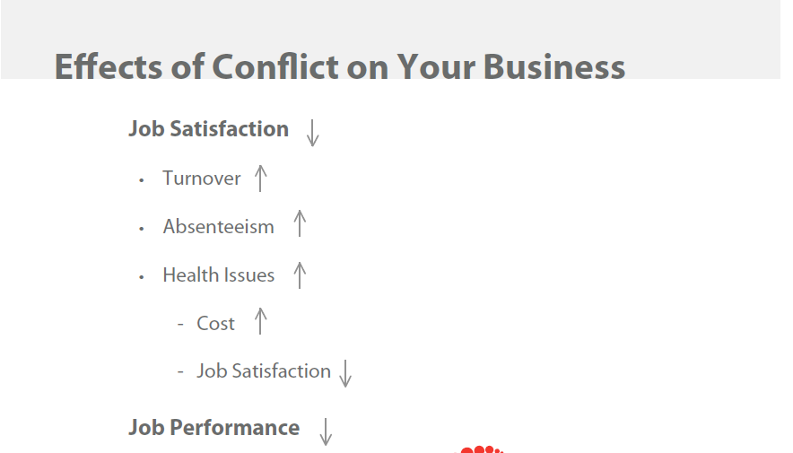
8. Effects of conflict on Business:

Slide 60
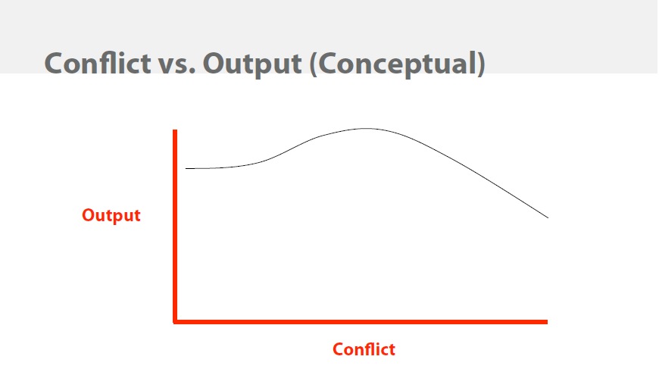

Slide 61

9.Survey results….
Results to be added

Slide 62
What This Means
10. Some Tips for Managing Workplace Conflict:
Managing conflict means you need to develop several styles and decide which is valuable at any given point of conflict
Notes:
As your examples show, the way you handle conflict now varies according to whether you are dealing with someone with whom you have a long or short term relationships, what you are trying to accomplish, and whether you feel the core of the conflict is worthy of your time and attention.
I would argue that while most of us know and can use multiple styles, most also tend to use only one. Consistent with the “Both/and” approach to globalization that we are studying in this course, it probably makes sense for you to learn and practice a variety of different conflict management styles. I hope this review might help you to do that.

Slide 63
Some Tips for Managing Workplace Conflict
Build good relationships before conflict occurs
Do not let small problems escalate; deal with them as they arise
Respect differences
Listen to others’ perspectives on the conflict situation
Acknowledge feelings before focussing on facts
Focus on solving problems, not changing people
If you can’t resolve the problem, turn to someone who can help
Remember to adapt your style to the situation and persons involved
Notes:
Adapted from Dispute Resolution Center of Snohomish and Island Counties (2004). 1801 Lomard Ave, Everett, WA 98206; 425-339-1335.

Slide 64
Steps for Positive Resolution
When the following conditions are in place, the likelihood of a positive resolution increases:
Commitment to find a resolution that is mutually beneficial.
Trust.
Frame of mind that there is more than one way to look at the issues.
Belief that a solution exists.
Commitment to stay in the communication process.

Slide 65

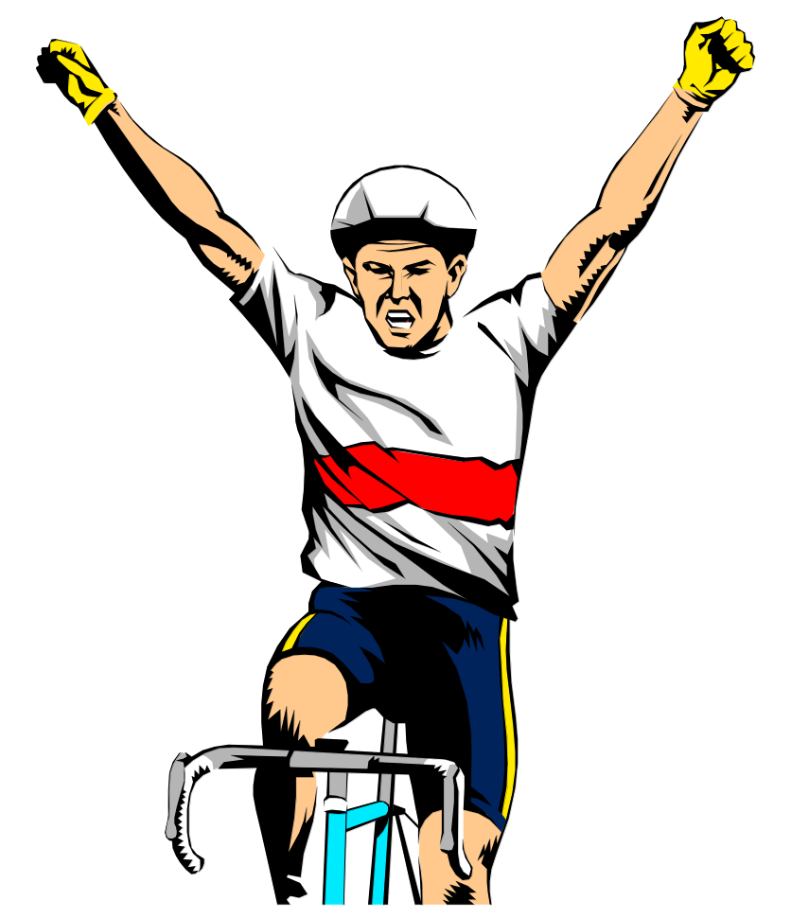
We made
it!

Slide 66
THANK YOU

